Slide 1



CSCI356 - Game Engine Essentials
Tim Oliver Krause
Matthias Biermanns
28.10.2025

Slide 2

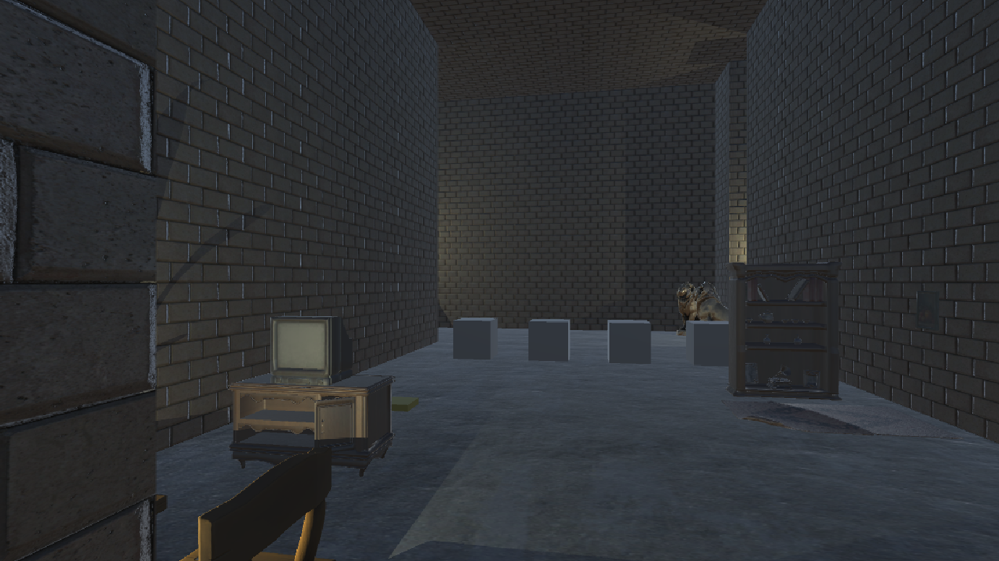


Game Mechanics
o First Person Shooter
o Action-Puzzle game
o Speedrun
o Level based
Start

Slide 3


Game Mechanics
Challenges
Game Mechanics
1) Grappling Hook
o First Person Shooter
o gravity suspension
o Action-Puzzle game
o Reel In
o Speedrun
2) Challenge Management
o Manager Interference
o Level based
o Order Enforcement
Start

Slide 4
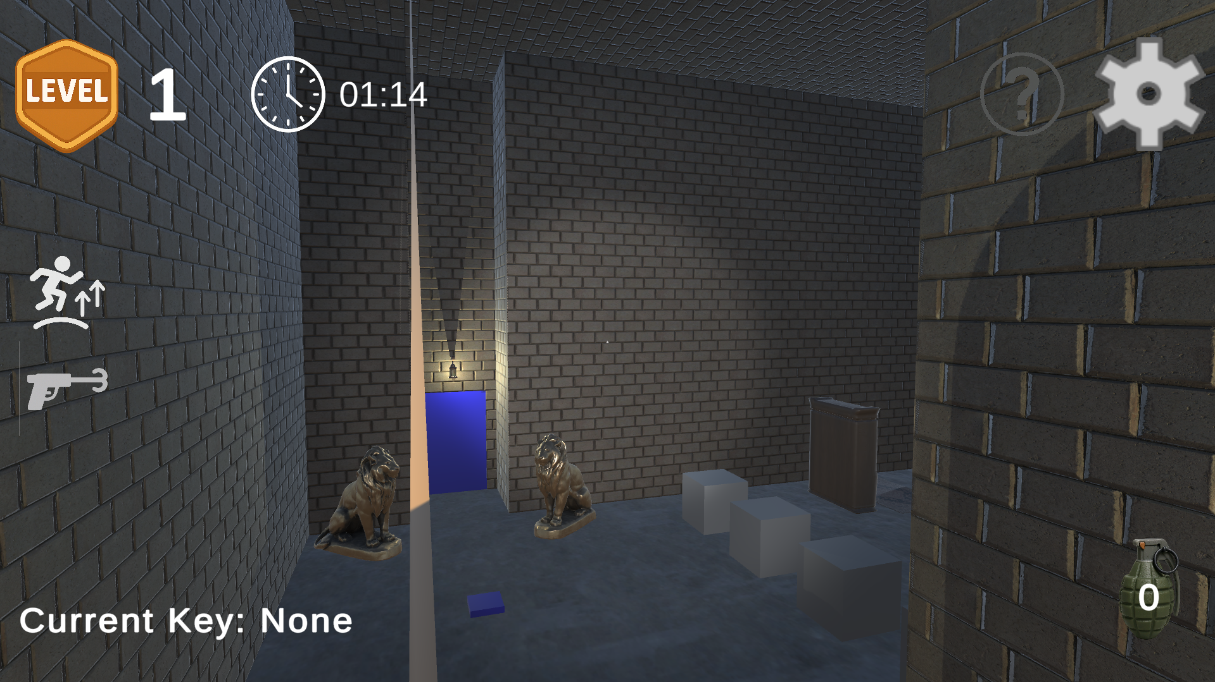
Game Mechanics
o First Person Shooter
o Action-Puzzle game
o Speedrun
o Level based
Start

Slide 5
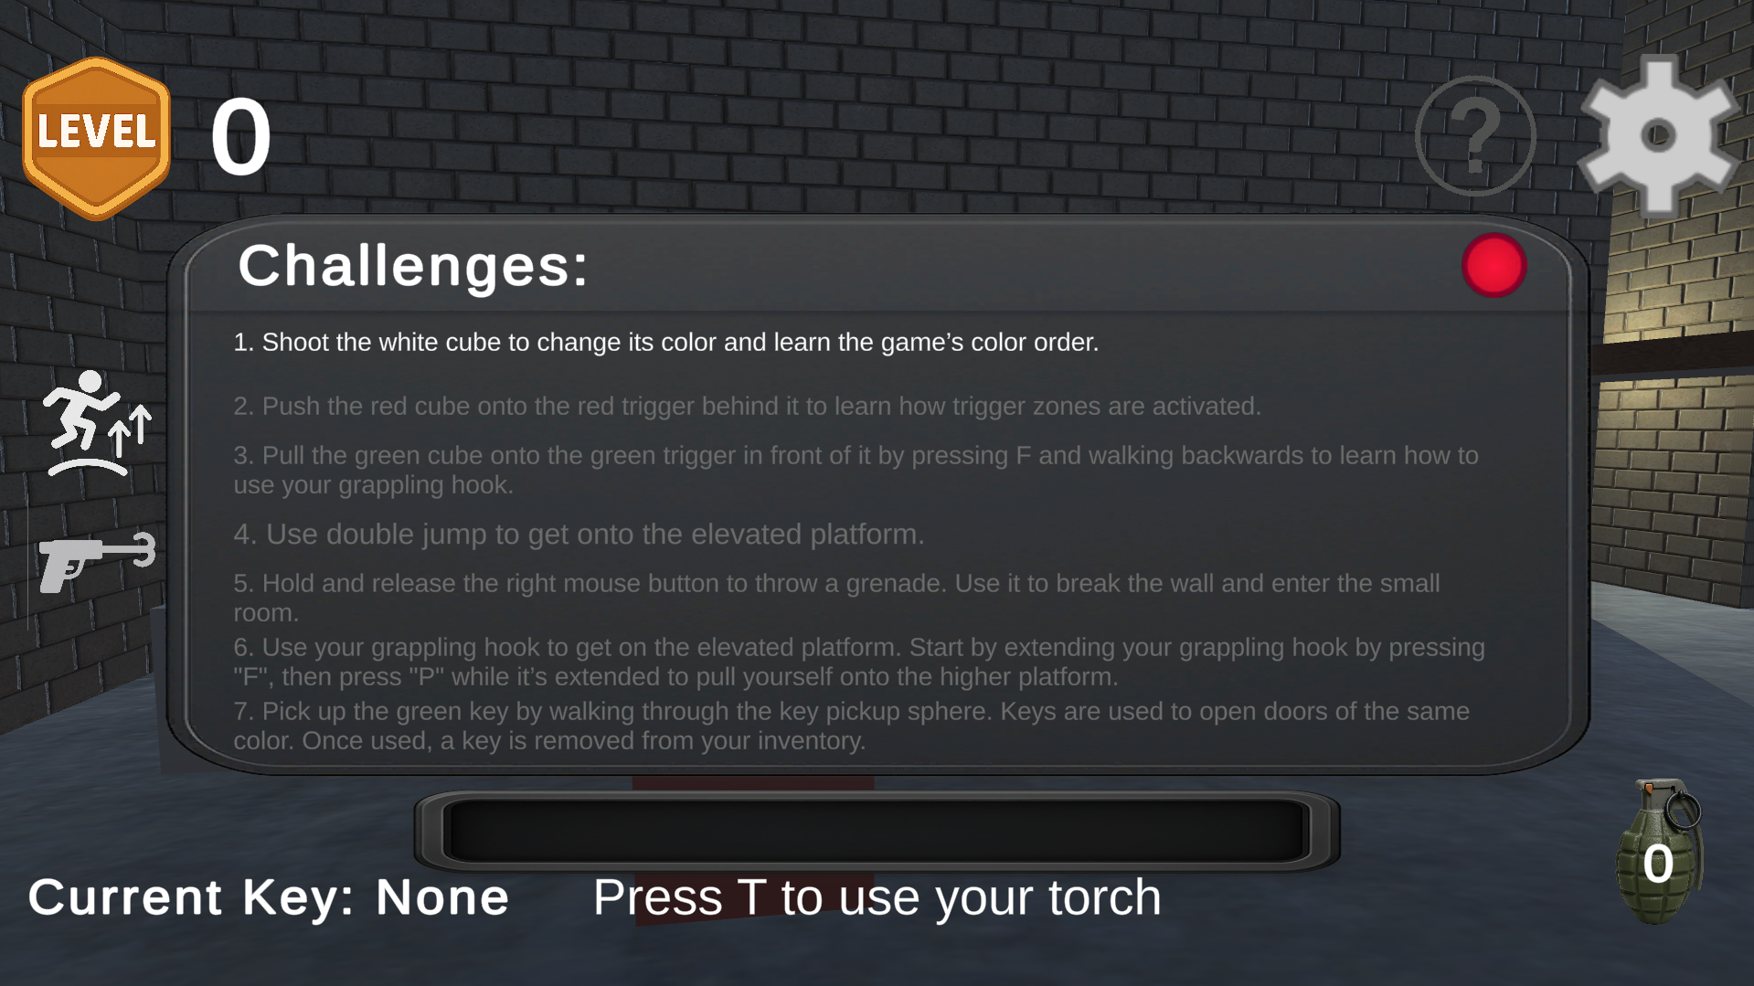
Game Mechanics
o First Person Shooter
o Action-Puzzle game
o Speedrun
o Level based
Start

Slide 6
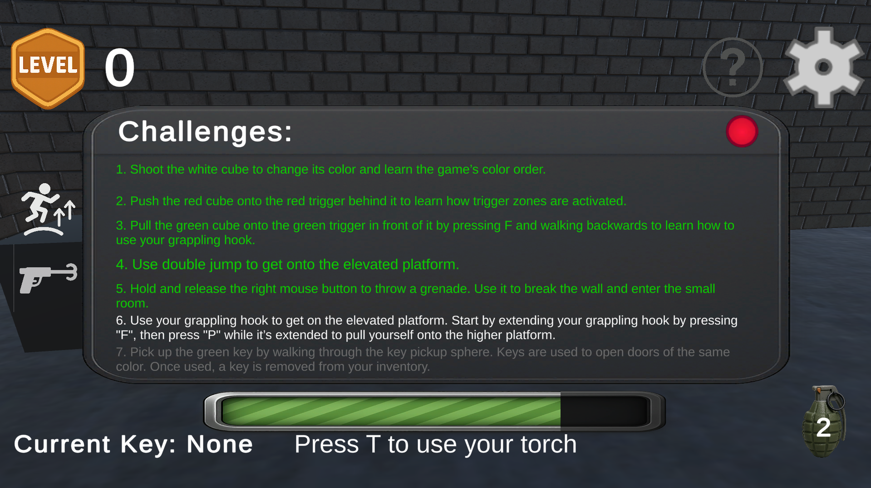
Game Mechanics
o First Person Shooter
o Action-Puzzle game
o Speedrun
o Level based
Start

Slide 7
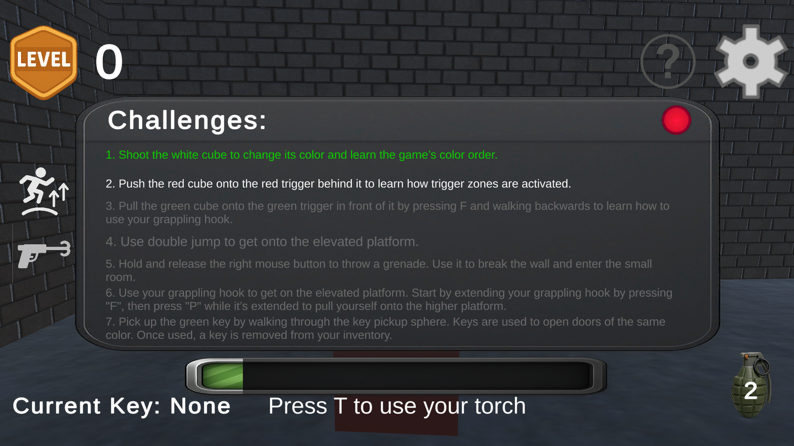
Optimizations
o Smart Object deactivation
o OnDemand Checks
o XXX
o XXX
Start
Notes:
On Demand checks: e.g. Challenges only check completion, if triggered by challenge manager

Slide 8
Optimizations
Technical Solutions
Game Mechanics
1) Grappling Hook
o Smart Object deactivation
o Deferred script execution
o OnDemand Checks
o external movement calculation
o XXX
2) Challenge Management
o Script Deactivatino
o XXX
o Centralized Challenge Management
Start

Slide 9
Game Mechanics
Optimizations
o Smart Object deactivation
o OnDemand Checks
Start

Slide 10

Leaderboard
- - : - -
Reset
Start Game
Skip Tutorial
28.10.2025

